Slide 1
Lab 4 OPERator overloading
DEE 1319
Department of Electronics Engineering
National Chiao Tung University

Slide 2
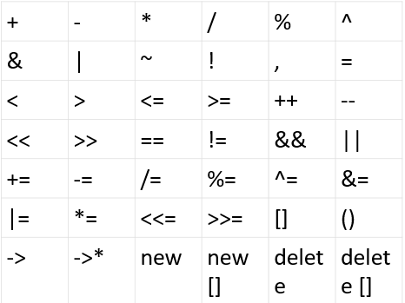
Why Operator Overloading?
C++ can overload operators to perform different operations depending on their context and data types.
Overloadable operators:

Slide 3
Operator Overloading
Define a member function operator+
class complex {
double re, im;
public:
complex(double r = 0.0, double i = 0.0) : re(r), im(i) { }
const complex operator+(const complex&) const;
};
const complex complex::operator+(const complex& rhs) const {
complex result(rhs); // using copy ctor, too
result.re += re; result.im += im;
return result;
}
int main() {
complex a(1, 1), b(2, 2), c;
c = a.operator+(b); // ok! explicit call, just ugly!
c = a + b; // ok! it is just a shorthand for operator+
}

Slide 4
Another Way for Operator Overloading
Overloaded operators are NOT necessarily member functions!
class complex {
double re, im;
public:
complex(double r = 0.0, double i = 0.0) : re(r), im(i) { }
double real() const { return re; }
double image() const { return im; }
};
const complex operator+(const complex& lhs, const complex& rhs) {
double real, image;
real = lhs.real() + rhs.real(); image = lhs.image() + rhs.image();
return complex(real, image);
}
int main() {
complex a(1, 1), b(2, 2), c;
c = operator+(a, b); // ok! explicit call, just ugly!
c = a + b; // ok! it is just a shorthand for operator+
}

Slide 5
Returning Constant Value
const complex operator+(const complex& lhs , const complex& rhs)
complex operator+(const complex& lhs , const complex& rhs)
int main() {
complex a(1,1), b(2,2), c(3,3);
(a + b) = c; // no error if using red one; error if using blue one
if((a+b) = c) // Oops, programmer actually wants => if((a+b) ==c)
do_things // again, no error if using red one; error if using blue one
}
Hence, blue one is preferred

Slide 6
Member vs. Nonmember Operators
If mixed-mode arithmetic is allowed e.g., allow adding a complex with a double
int main() { // operator+ is a member function here
complex a(1,1), b;
b = a + 1.0; // ok! a.operator+( complex(1.0) )
b = 1.0 + a; // error! 1.0.operator+(a) <= no such function!
}
int main() { // operator+ is a nonmember function here
complex a(1,1), b;
b = a + 1.0; // ok! operator+( a, complex(1.0) )
b = 1.0 + a; // ok! operator+( complex(1.0), a )
}
In general, nonmember version is preferred

Slide 7
Friend Functions (1/3)
Nonmember functions
- access private members through accessors and mutators
- inefficient (overhead of calls to accessors and mutators)
Friend functions can directly access private members
- same access privilege as member functions
- no calls to accessors and mutators =>more efficient
You can make specific nonmember functions friends for better efficiency!

Slide 8
Friend Functions (2/3)
class complex {
double re, im;
public:
complex(double r = 0.0, double i = 0.0) : re(r), im(i) { }
double real() const { return re; }
double image() const { return im; }
friend const complex operator+(const complex&, const complex&);
};
const complex operator-(const complex&, const complex&);

Slide 9
Friend Functions (3/3)
// no need to add friend prefix in function definition
const complex operator+(const complex& lhs, const complex& rhs) {
complex result(lhs);
result.re += rhs.re; result.im += rhs.im;
return result;
} // a friend function has same access privilege as member functions
const complex operator-(const complex& lhs, const complex& rhs)
double real = lhs.real() + rhs.real();
double image = lhs.image() + rhs.image();
return complex(real, image);
} // need accessors to get private data

Slide 10
Overload <<
ostream& operator<<(ostream& os, const complex& rhs) {
os << rhs.real() << ‘+’ << rhs.image() << ‘i’ ;
return os;
}
int main(){
complex a(2,3), b(4,5);
cout << a << endl << b << endl; // more elegant!
}
Output:
2+3i
4+5i
It is common to make operator<< a friend

Slide 11
Return Value of Operator <<
If you make operator<< return void …
void operator<<(ostream& os, const complex& rhs) {
os << rhs.real() << ‘+’ << rhs.image() << ‘i’ ;
}
int main() {
complex a(2,3), b(4,5);
cout << a << endl << b << endl; // compilation error!
} void

Slide 12

Overload >>
You can use “cin >>” for user-defined types
first, make istream& operator>>(istream&, complex&) a friend
istream& operator>>(istream& is, complex& rhs) {
is >> rhs.re >> rhs.im ;
return is;
}
int main() {
complex a, b;
cin >> a >> b;
cout << a << endl << b << endl;
}

Slide 13
Exercise (1/3)
Create a class Complex and provide the following functions.
2 private data members :
double re : real part
double im : Imaginary part
You have to finish the missing part of the code.
constructor Complex(double r, double i)
Take r as the real part and i as the Imaginary part
operator+, operator-, operator*, operator+=, operator==, operator!= on Complex
operator<< and operator>> for output/input Complex

Slide 14
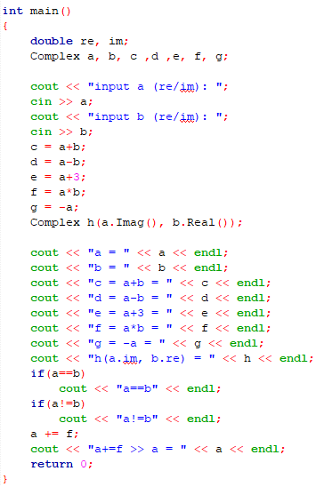
Exercise (2/3)
The main function is provided and you cannot modify the main function.

Slide 15
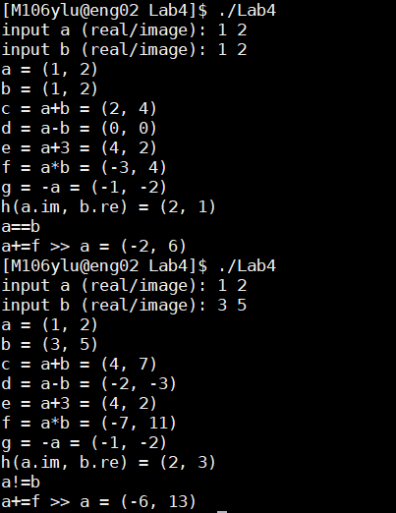
Exercise (3/3)
Sample input/output

Slide 16
Homework (1/4)
Create a class fraction_t and provide the following functions
2 private data members : int type
Used to store the numerator and the denominator respectively
Default constructor fraction_t() should initialize the value to 0
Constructor fraction_t(int n, int d)
Take n as the numerator and d as the denominator
Operator+, operator-, operator*, operator/ on fraction_t
Operator<< and operator>> for output/input fraction_t
The output format is : numerator/denominator
Always in reduced form
The input format is : numerator denominator
The input of the denominator won’t be 0

Slide 17
Homework (2/4)
The main function is provided and you cannot modify the main function.
The main function acts like a calculator
It always keep a value v
v initialize to 0
User enter an operation op (+,-,*,/)
Then user enter a fraction f
The calculator do
v = v op f (ex. v = v + f)
Print v and wait for next operation
If op is not (+-*/), then end the program.

Slide 18
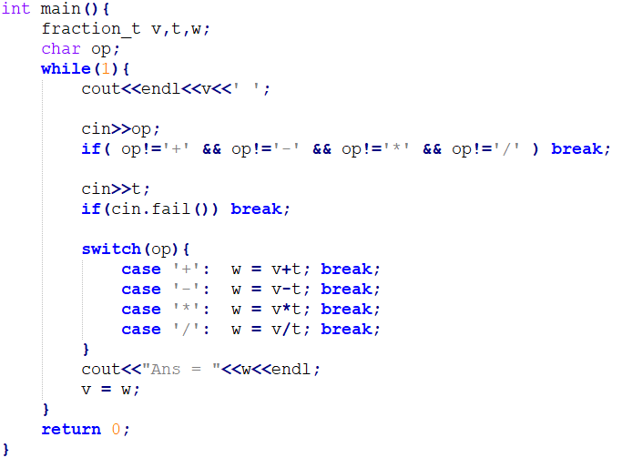
Homework (3/4)

Slide 19
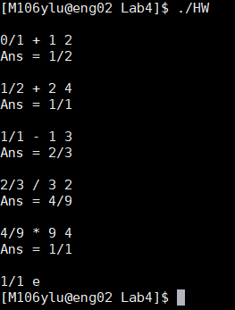
Homework (4/4)
Sample input/output
Input are shown in THIS
0/1 + 1 2 (your input)
Ans = 1/2
1/2 + 2 4
Ans = 1/1
1/1 - 1 3
Ans = 2/3
2/3 / 3 2
Ans = 4/9
4/9 * 9 4
Ans = 1/1
1/1 e
[end]

